Slide 1
Glyoxylate Cycle
Liang Zhang
BMS
Liangzhang.28@cityu.edu.hk
Tel: 3442-4495

Slide 2
The citric acid cycle is also a source of biosynthesis precursors
We can use glucose to make other building blocks,
but not all roads are open!
Notes:
Not all are revisible.

Slide 3
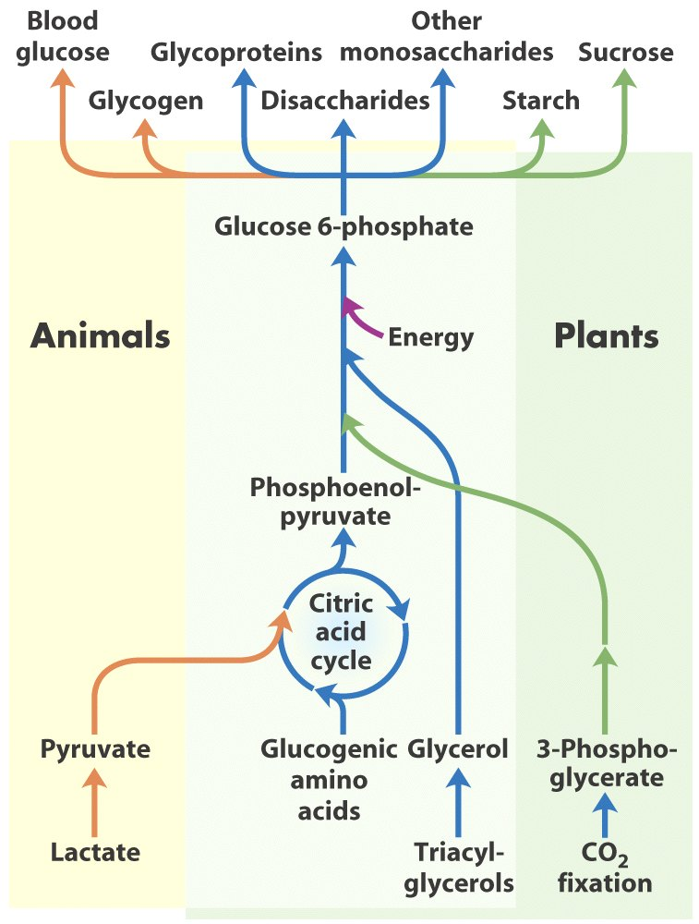
It would be great if……
The degradation product of lipid (fat) is glycerol and fatty acid. Fatty acids can be broken down to acetyl-CoA.
If pyruvate ⇌ acetyl CoA is reversible, then there is a SWEET way of burning fat:
Remember pyruvate can be used for gluconeogenesis through reactions catalyzed sequentially by pyruvate carboxylase and PEP carboxykinase, consuming ATP and GTP:
Pyruvate ⇌ Oxaloacetate ⇌ PEP
Then we can generate glucose from fat!! Glucose can be consumed efficiently!
Great way to lose weight, right?
Fatty acids
Acetyl-CoA
Oxaloacetate

Slide 4
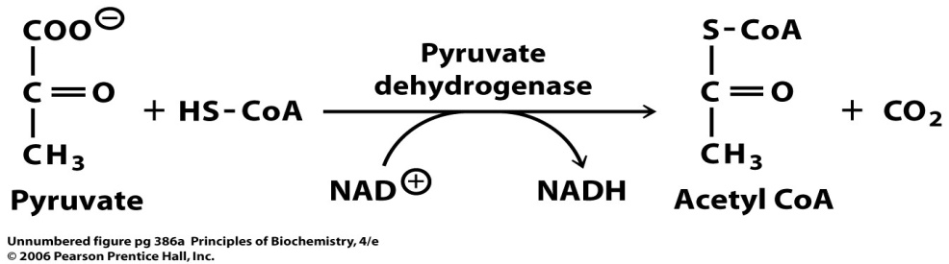
However……
However, acetyl-CoA (2C) units cannot be converted back to 3C intermediates, such as glycerol or pyruvate.
Acetyl CoA cannot be carboxylated to pyruvate because the reaction by pyruvate dehydrogenase is practically irreversible.
ΔG^{’o} = -33.4 kJ/mol
Fatty acids
Acetyl-CoA
Oxaloacetate

Slide 5
Yet it is impossible just in our animals
Fatty acids cannot be converted to glucose in animals.
Many bacteria and plants make use of a metabolic pathway that converts two-carbon acetyl units into four-carbon units (succinate) for energy production and biosynthesis.
This reaction sequence, called the glyoxylate cycle, bypasses the two decarboxylation steps of the citric acid cycle.
Fatty acids
Acetate
Oxaloacetate

Slide 6
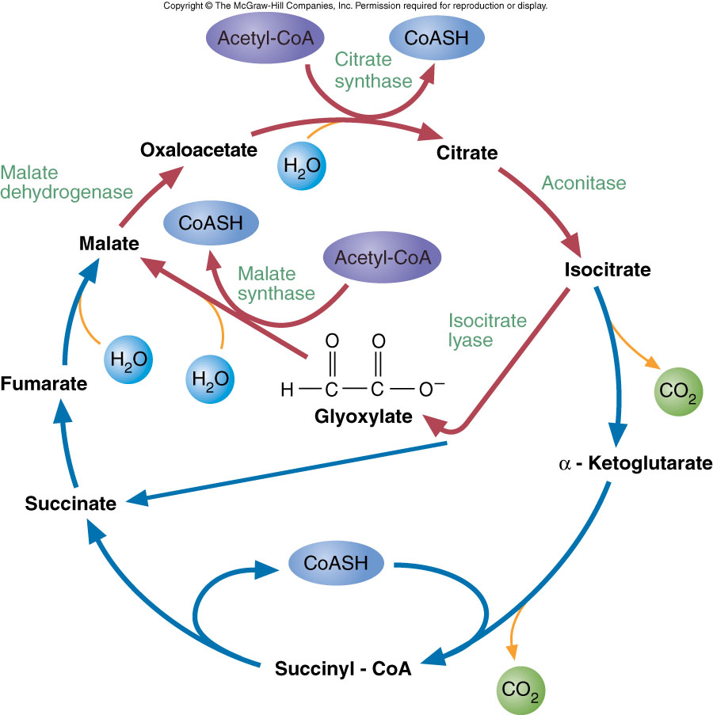
The Glyoxylate Cycle
This reaction sequence, called the glyoxylate cycle, bypasses the two decarboxylation steps of the citric acid cycle.
So in glyoxylate cycle:
1 oxaloacetate + 2 acetyl-coA → 2 oxaloacetates
The extra oxaloacetate gets to be used for other purpose (e.g. gluoconeogenesis.
But in citric acid cycle:
1 oxaloacetate + 2 acetyl-coA → 1 oxaloacetate + 2 CO2.
We animals do not have the two enzymes of the glyoxylate cycle.
Bypassing CO2 formations, conversion of acetyl CoA to succinate, then to oxaloacetate or into other pathways.

Slide 7
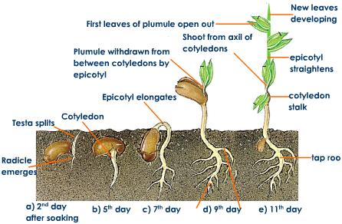
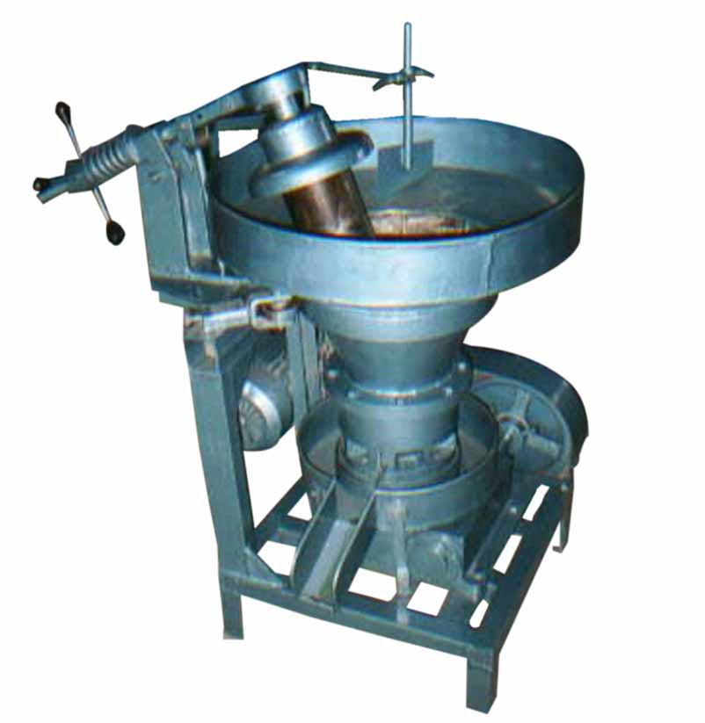
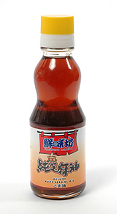
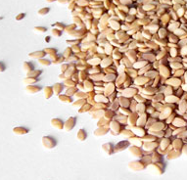
Seed germination uses fatty acids as energy source
In plants, yeast, and many bacteria, they can convert acetyl CoA to oxaloacetate by another pathway, called the glyoxylate cycle.
In plant during the germination of seedlings, the conversion of fatty acids (from seed oils) into oxaloacetate and then glucose is important before the leaves of the seedlings develop and photosynthesis can provide energy and make carbohydrates for the synthesis of cell wall.
Sesame oil

Slide 8
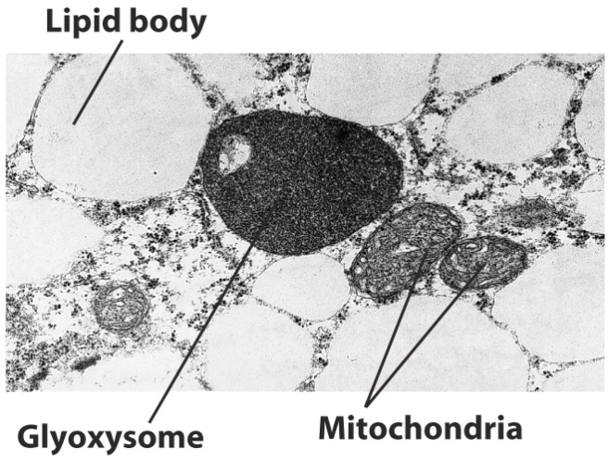
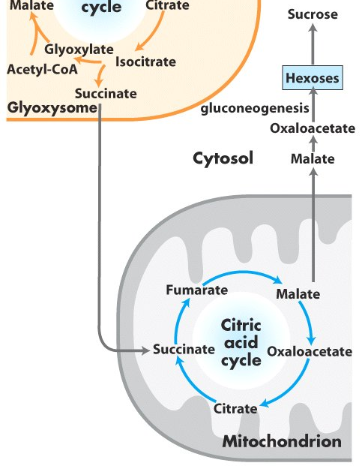
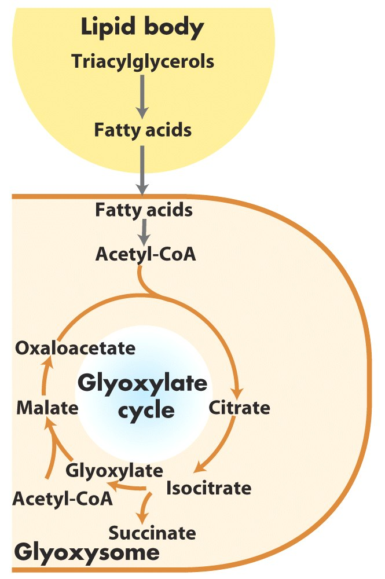
Glyoxysomes makes succinate from lipid to
support gluconeogenesis

Slide 9
Summary of objectives
Acetyl-CoA cannot be directly converted back to pyruvate.
Glyoxylate cycle makes the acetyl-CoA → pyruvate conversion in plants
Animals lack the two enzymes.

Slide 10
Oxidative Phosphorylation
Liang Zhang
BMS
Liangzhang.28@cityu.edu.hk
Tel: 3442-4495

Slide 11
Overview
Carbohydrates
Glucose
(and other six-carbon sugars, e.g. fructose, galactose)
Gluconeogenesis
Glycolysis
Pyruvate
– O2
Fermentation
+ O2
ATP
Citric acid cycle
Oxidative Phosphorylation
CO2 + H2O
Notes:
Coming down to the final step.

Slide 12
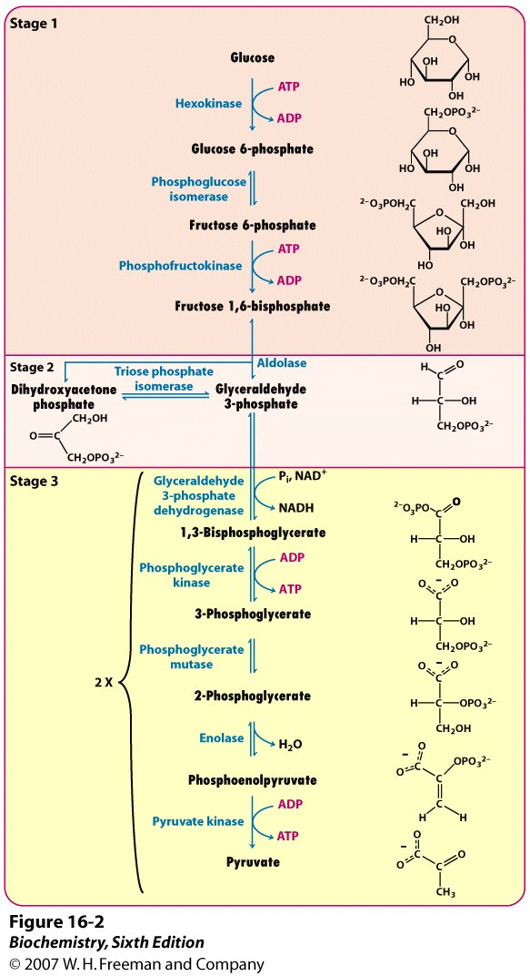

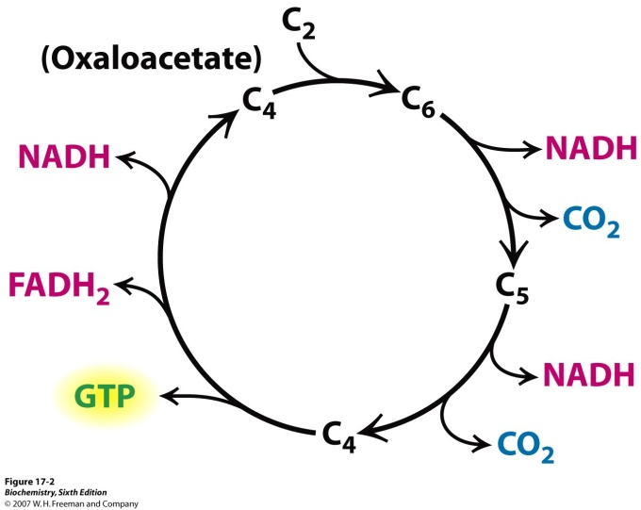
Where does the energy come from?
Up to here, there are only 4 ATP molecules made per glucose molecule.
But there are 12 NADH/FADH created that can generate more ATP molecules by another process called oxidative phosphorylation.

Slide 13
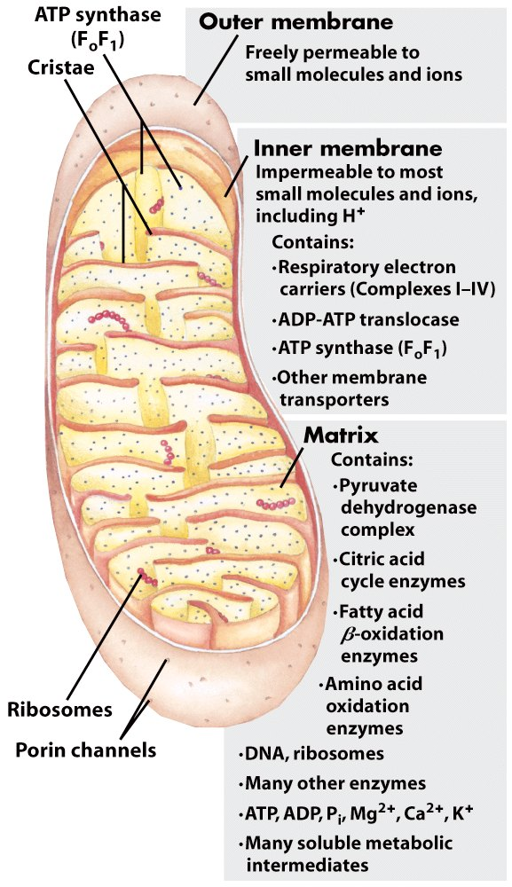
Oxidative phosphorylation
Oxidative phosphorylation is the culmination of energy-yielding metabolism in aerobic organisms.
Technically, oxidative phosphorylation contains two processes: the enzymatic phosphorylation of ADP to ATP coupled to electron transfer from a substrate to molecular oxygen.
In eukaryotes, oxidative phosphorylation occurs in the mitochondria.
Oxidative phosphorylation reduces oxygen to water by the electrons from NADH and FADH2.

Slide 14
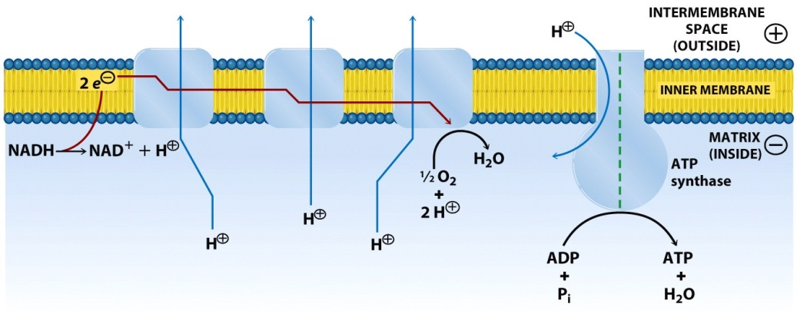
Oxidative phosphorylation
Oxidative phosphorylation is the process in which ATP formation is coupled to the transfer of electrons from NADH or FADH₂ to O₂ by a series of electron carriers. And the coupling mechanism is creating a proton gradient.

Slide 15
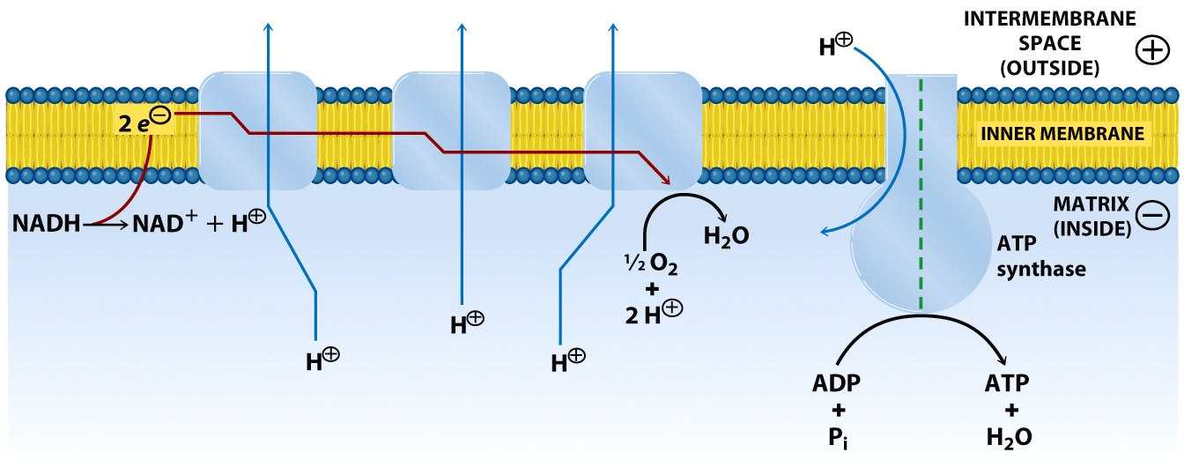
Oxidative phosphorylation depends on electron transfer
The highly energetically favorable reduction of molecular oxygen by NADH and FADH₂ occurs in a number of electron-transfer reactions, taking place in a set of membrane proteins known as the electron-transport chain.
Mechanistically, the flow of electrons from NADH or FADH₂ to O₂ through protein complexes located in the mitochondrial inner membrane leads to the pumping of protons out of the mitochondrial matrix. The resulting uneven distribution of protons generates a pH gradient and a transmembrane electrical potential that creates a proton-motive force. ATP is synthesized when protons flow back to the mitochondrial matrix through an enzyme complex. Thus, the oxidation of fuels and the phosphorylation of ADP are coupled by a proton gradient across the inner mitochondrial membrane.
Notes:
Two process coupled together. Recycle NAD electron move as pairs coQ take a pair, but transfer one at a time. No o2, can not convert NADH to NAD.

Slide 16
Summary of objectives
Oxidative phosphorylation occurs in the mitochondria.
Oxidative phosphorylation includes the enzymatic phosphorylation of ADP to ATP coupled to electron transfer from a substrate to molecular oxygen.
Electron transfer takes place through several membrane complexes and create a gradient of protons.

Slide 17
Electron carriers in mitochondria
Flavin mononucleotide (FMN)
Iron-sulfur proteins
Ubiquinone
Cytochromes

Slide 18
Flavin Mononucleotide (FMN)
Flavin Mononucleotide
(FMN)
Semiquinone intermediate
Reduced Flavin Mononucleotide
(FMNH₂)

Slide 19
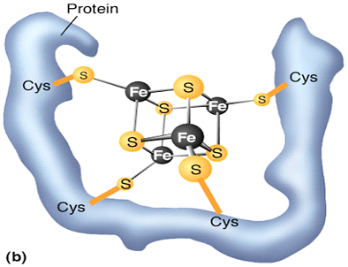
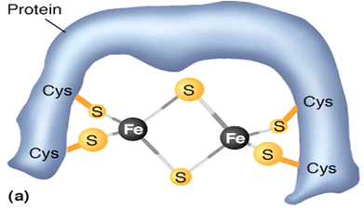
Iron-sulfur cluster
Several types of Fe-S clusters are known. Iron ions in these Fe-S complexes cycle between Fe²⁺ (reduced) or Fe³⁺ (oxidized) states.
a single iron ion is tetrahedrally coordinated to the sulfhydryl groups of four cysteine residues of the protein
contains two iron ions and two inorganic sulfides (denoted by 2Fe-2S). Such clusters are usually coordinated by four cysteine residues, although exceptions exist
contains four iron ions, four inorganic sulfides, and four cysteine residues (designated 4Fe-4S).
2Fe-2S
4Fe-4S
NADH-Q reductase contains both 2Fe-2S and 4Fe-4S clusters.

Slide 20
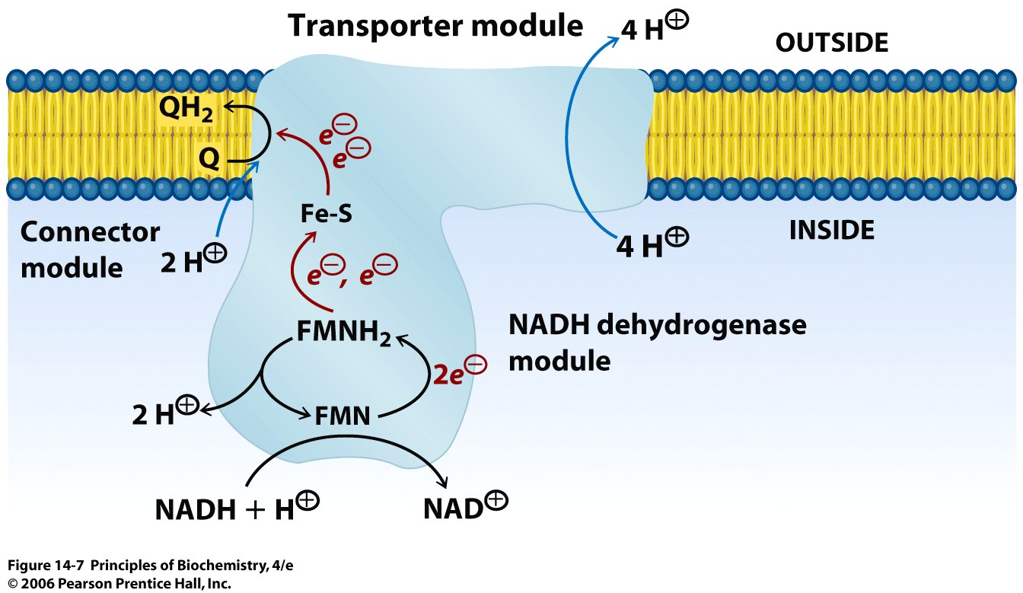
NADH-Q oxidoreductase (Complex I)
NADH-Q oxidoreductase (NADH dehydrogenase) is L-shaped, with a horizontal arm lying in the membrane and a vertical arm that projects into the matrix.
NADH transfers two high-potential electrons to the flavin mononucleotide (FMN) prosthetic group of complex I to give FMNH₂. Electrons are then transferred from FMNH₂ to a series of iron-sulfur clusters (abbreviated as Fe-S), the second type of prosthetic group in NADH-Q reductase. Electrons in the iron-sulfur clusters of NADH-Q reductase are then shuttled to coenzyme Q.
The flow of two electrons from NADH to coenzyme Q through NADH-Q oxidoreductase leads to the pumping of four hydrogen ions out of the matrix of the mitochondrion!!! (the mechanism of proton pumping is not clear)
http://www.rcsb.org/pdb/explore/jmol.do?structureId=2FUG&bionumber=1

Slide 21
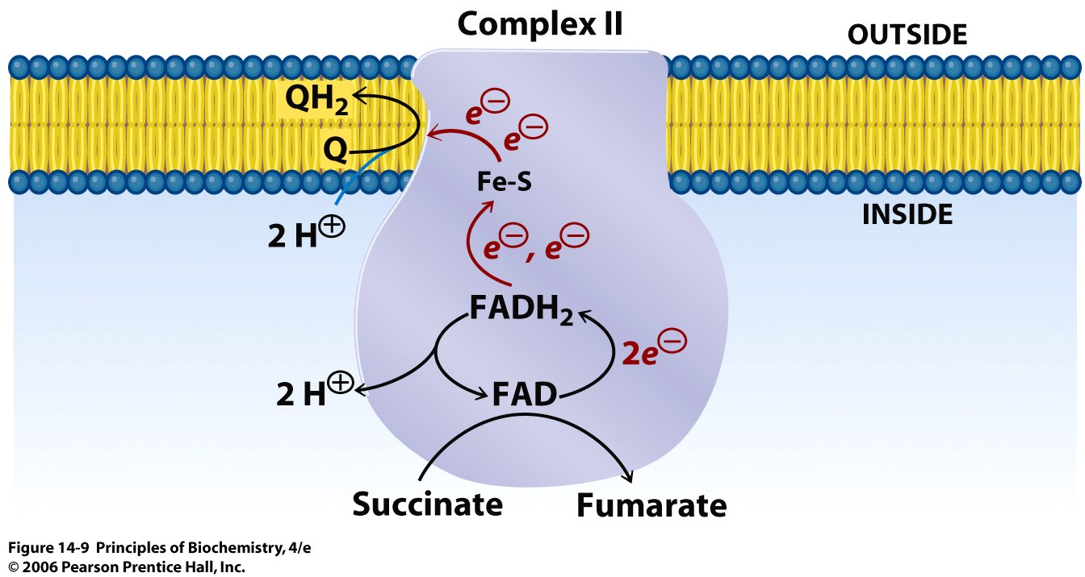

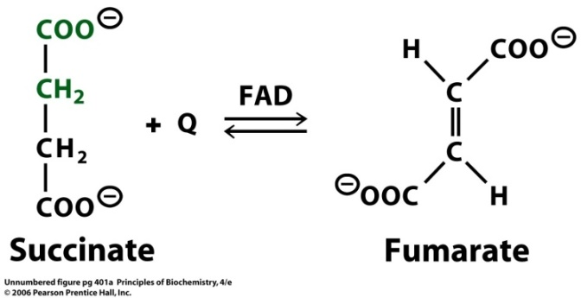
Succinate - Q reductase (Complex II)
Succinate dehydrogenase
+FADH₂
The citric acid cycle enzyme succinate dehydrogenase, which generates FADH₂ with the oxidation of succinate to fumarate, is a part of Complex II.
FADH₂ does not leave the complex: its electrons are transferred to Fe-S centers and then to Q for entry into the electron-transport chain.
The succinate-Q reductase complex and other enzymes that transfer electrons from FADH₂ to Q do not transport protons (so less ATP is formed from the oxidation of FADH₂ than from NADH).

Slide 22
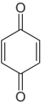
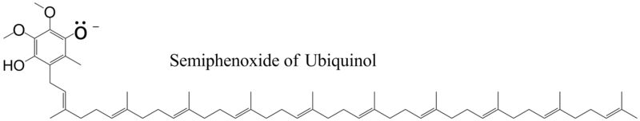
Coenzyme Q
Coenzyme Q is known as ubiquinone because it is a ubiquitous quinone in biological systems. Ubiquinone is a hydrophobic quinone that diffuses rapidly within the inner mitochondrial membrane. Coenzyme Q is a quinone derivative with a long isoprenoid tail. The number of five-carbon isoprene units in coenzyme Q depends on the species.
ubiquinone

Slide 23
Coenzyme Q
Fully-oxidized form
Q (ubiquinone)
Semiquinone
Q^{•−}
Fully-reduced form
QH₂ (ubiquinol)
Quinones can exist in three oxidation states.
In the fully oxidized state (Q), coenzyme Q has two keto groups.
The addition of one electron and one proton results in the semiquinone form (QH•).
The semiquinone form is relatively easily deprotonated to form a semiquinone radical anion (Q^{•−}). The addition of a second electron and proton generates ubiquinol (QH₂), the fully reduced form of coenzyme Q, which holds its protons more tightly.
Thus, for quinones, electron-transfer reactions are coupled to proton binding and release, a property that is key to transmembrane proton transport.

Slide 24
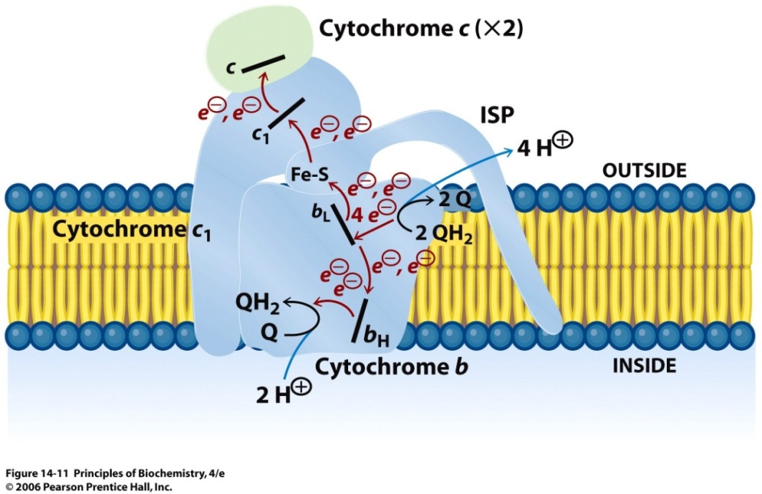
Q-cytochrome c oxidoreductase (Complex III)
http://www.rcsb.org/pdb/explore/jmol.do?structureId=1KYO&bionumber=1
The function of Q-cytochrome c oxidoreductase is to catalyze the transfer of electrons from QH₂ to oxidized cytochrome c (cyt c), a water-soluble protein, and concomitantly pump protons out of the mitochondrial matrix.
A cytochrome is an electron-transferring protein that contains a heme prosthetic group. The iron ion of cytochrome alternates between Fe²⁺ and Fe³⁺ during the electron transport.
Notes:
Very complicated complex

Slide 25
Cytochrome c oxidase (Complex IV)
Cytochrome C oxidase accepts electrons from reduced cytochrome c and uses them to reduce molecular oxygen to water.
Cytochrome c oxidase contains two heme A (heme a and heme a₃ Fe) groups and three copper ions, arranged as two copper centers (Cu_{A} and Cu_{B}).
Together, heme a₃ and Cu_{B} form the active center at which O₂ is reduced to H₂O.

Slide 26
Reactive Oxygen Species (ROS)
The transfer of four electrons leads to safe products (two molecules of H₂O), but electrons have to be transferred one-by-one. This creates a problem: partial reduction generates hazardous compounds (e.g. superoxide, hydroxyl radical •OH and hydrogen peroxide are highly toxic to cells).
O₂
e⁻
O₂^{•−}
e⁻
O₂²⁻
superoxide
peroxide
The cytochrome oxidase and other proteins that reduce O₂ have been designed not to release superoxide. However, a small amount of superoxide anion is unavoidably formed. Superoxide anion can be scavenged by superoxide dismutase:
2H⁺
O₂^{•−}
+ O₂^{•−}
H₂O₂ + O₂
superoxide dismutase
The hydrogen peroxide formed is scavenged by catalase:
H₂O₂
+ H₂O₂
catalase
2H₂O + O₂
The free radicles oxidize and cross-link biomolecules they contact inside the cells. Therefore, the aging process of animals is partially because of the accumulating effect of the damage of ROS on cellular organelles.

Slide 27
Animations on the electron transfer process
https://www.youtube.com/watch?v=LQmTKxI4Wn4

Slide 28
Summary of objectives
The electron transfer chain involves compounds that receive and release electrons.
At the other end of the chain, oxygen receives electrons one by one.
This may lead to the formation of reactive oxygen species.

Slide 29
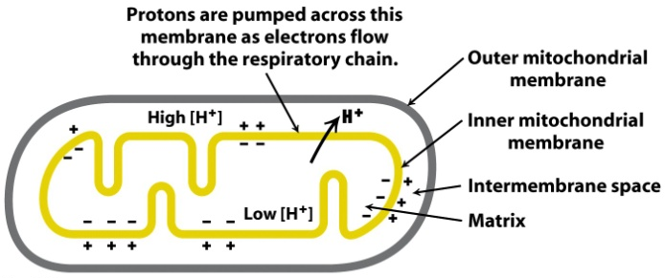
Electron transfer and ATP synthesis
The respiratory chain and ATP synthase are biochemically separated systems, linked only by a proton-motive force.
Notes:
Inner membrane of mit: impermeable to H+; control where H+ comes in.

Slide 30
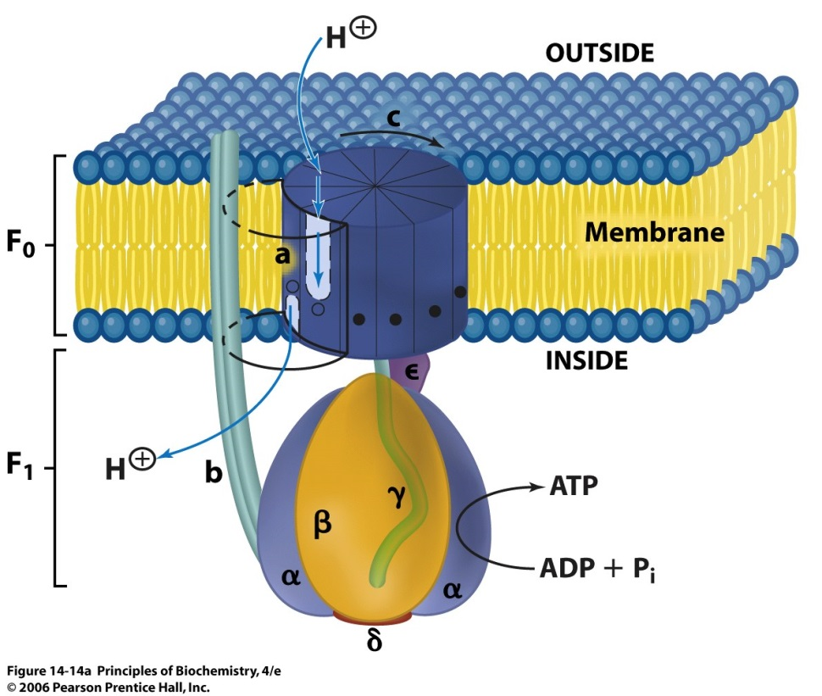
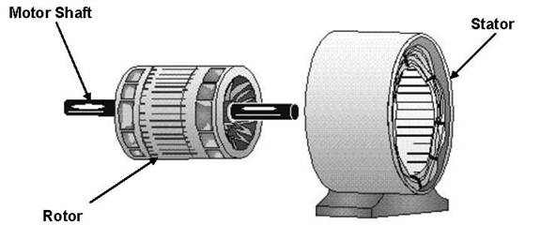
ATP Synthase (Complex V)
http://www.sigmaaldrich.com/sigma-aldrich/areas-of-interest/life-science/metabolomics/learning-center/metabolic-pathways/atp-synthase/atp-animation.html
Motor
The F₁ subunit consists of five types of polypeptide chains (3×α, 3×β, γ, δ, and ε), its role is to catalyze the synthesis of ATP.
F₀ contains the proton channel of the complex. This channel consists of a ring comprising from 10 to 14 c subunits that are embedded in the membrane. A single a subunit binds to the outside of this ring. The proton channel depends on both the a subunit and the c ring.
The F₀ and F₁ subunits are connected in two ways, by the central γε stalk and by an exterior column (consists of one a subunit, two b subunits, and the δ subunit). We can think of the enzyme as consisting of two functional components: (1) a moving unit, or rotor, consisting of the c ring and the γε stalk, and (2) a stationary unit, or stator, composed of the remainder of the molecule.
Notes:
The best example of molecular motor.

Slide 31
ATP Synthase (Complex V)
http://www.sigmaaldrich.com/sigma-aldrich/areas-of-interest/life-science/metabolomics/learning-center/metabolic-pathways/atp-synthase/atp-animation.html
Motor
Video explanation:
https://www.youtube.com/watch?v=PjdPTY1wHdQ&t=91s
Notes:
The best example of molecular motor.

Slide 32
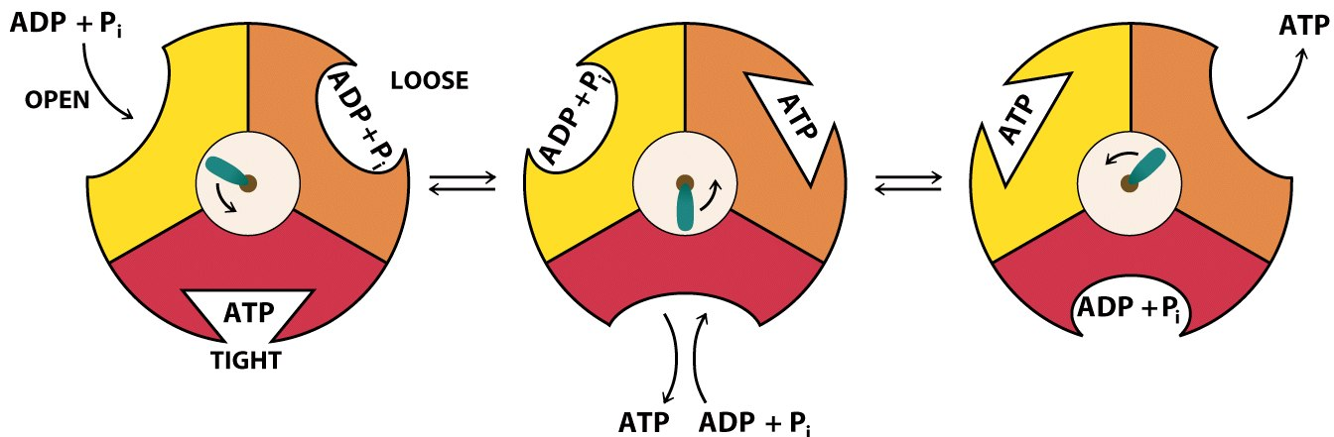
Binding-change model for ATP Synthase
In 1979, Paul Boyer proposed a binding-change mechanism for proton-driven ATP synthesis. This proposal states that changes in the properties of the three β subunits allow sequential (1) ADP and P_{i} binding, (2) ATP synthesis, and (3) ATP release:
Interactions with the γ subunit make the three β subunits nonequivalent (the different conformations of the three catalytic sites are indicated by different shapes).
ADP and P_{i} bind to the yellow site in the open conformation. As the γ shaft rotates in the counter-clockwise direction driven by the proton motive force, the α β subunit in contact is converted to a loose conformation where ADP and P_{i} are more firmly bound.
Following the next step of the rotation, the yellow site is converted to a tight conformation and ATP is synthesized. Meanwhile, the site that had bound ATP tightly has become an open site, and a loose site containing other molecules of ADP and P_{i} has become a tight site. ATP is released from the open site, and ATP is synthesized in the tight site.
γ
β

Slide 33
ATP Yield of Oxidation of Glucose
The ATP yield of oxidative phosphorylation is not very certain because the stoichiometries of proton pumping, ATP synthesis, and metabolite transport processes need not be integer numbers or even have fixed values.
The best current estimates for the number of protons pumped out of the matrix by NADH-Q oxidoreductase, Q-cytochrome c oxidoreductase, and cytochrome c oxidase per electron pair are four, four, and two, respectively.
The synthesis of a molecule of ATP is driven by the flow of about three protons through ATP synthase. An additional proton is consumed in transporting ATP from the matrix to the cytosol. (4 proton/ATP synthesized and transported).
Hence, about 2.5 molecules of cytosolic ATP are generated as a result of the flow of a pair of electrons from NADH to O₂. For electrons that enter at the level of Q-cytochrome c oxidoreductase, such as those from the oxidation of succinate or cytosolic NADH, the yield is about 1.5 molecules of ATP per electron pair. Hence, about 30 molecules of ATP are formed when glucose is completely oxidized to CO₂.
3 H⁺ synthesize 1 ATP molecule
4 H⁺ synthesize and transport 1 ATP molecule

Slide 34
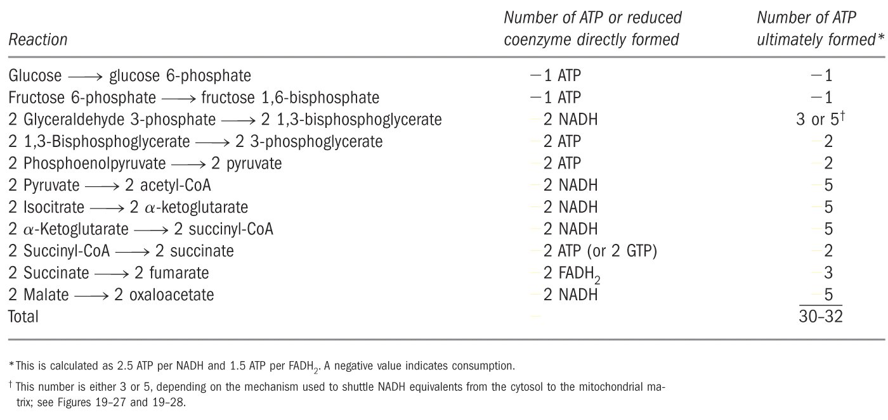
Complete oxidation of glucose
yields 30 or 32 ATP molecules

Slide 35
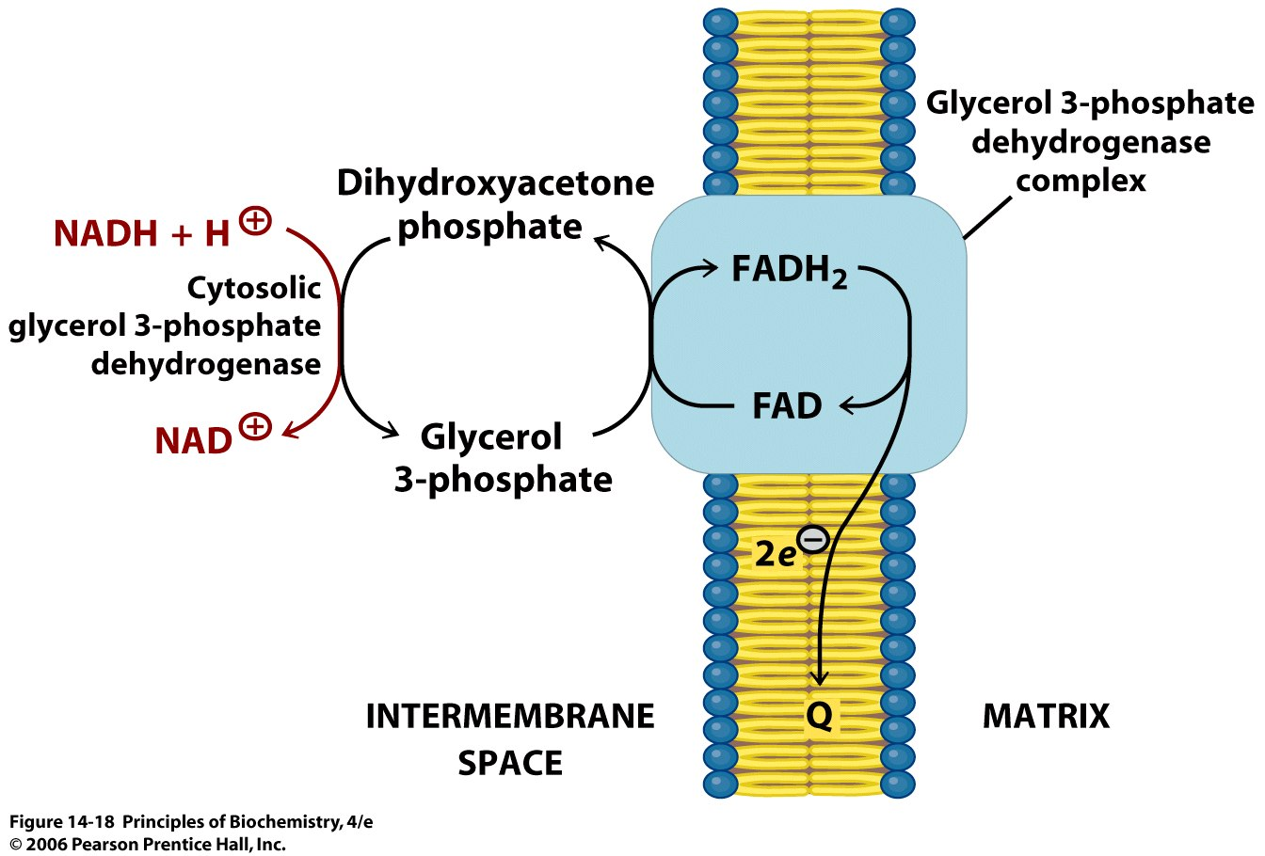
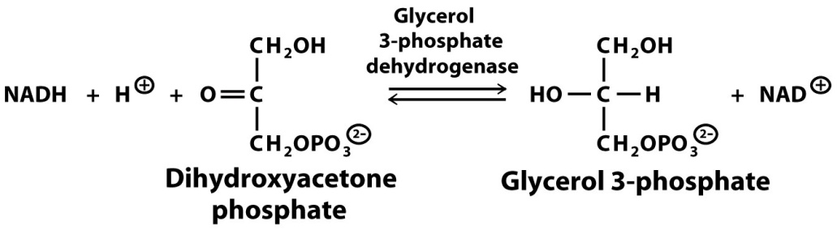
The NADH shuttle mechanism
The inner mitochondrial membrane is impermeable to NADH and NAD⁺. The glycerol 3-phosphate shuttle and malate-aspartate shuttle help to pass the reducing power of NADH to the electron transport chain.
Glycerol 3-phosphate shuttle (through FAD, so 3 ATP, not 5 from 2 NADH):
Do not mix it up with the enzyme that convert dihydroxyacetone phosphate to glyceraldehyde 3-phosphate by triose phosphate isomerase

Slide 36
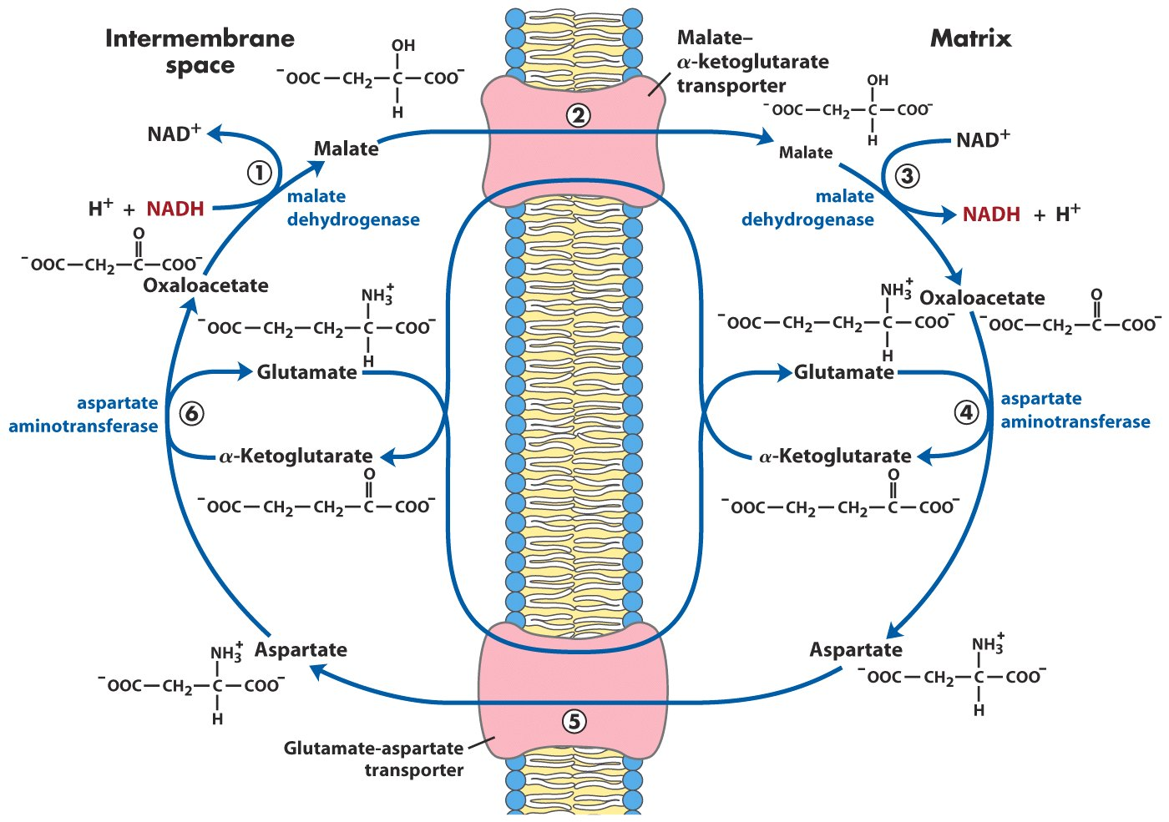
There is a way to get 5 –
malate-aspartate shuttle
(dicarboxylic acid transporter)
NADH in the cytosol reduces oxaloacetate to malate, which is transported into the mitochondrial matrix.
The re-oxidation of malate generates NADH that can pass electrons to the electron transport chain.
Completion of the shuttle cycle requires the activities of mitochondrial and cytosolic aspartate transaminase.
(Amino acid transporter)

Slide 37
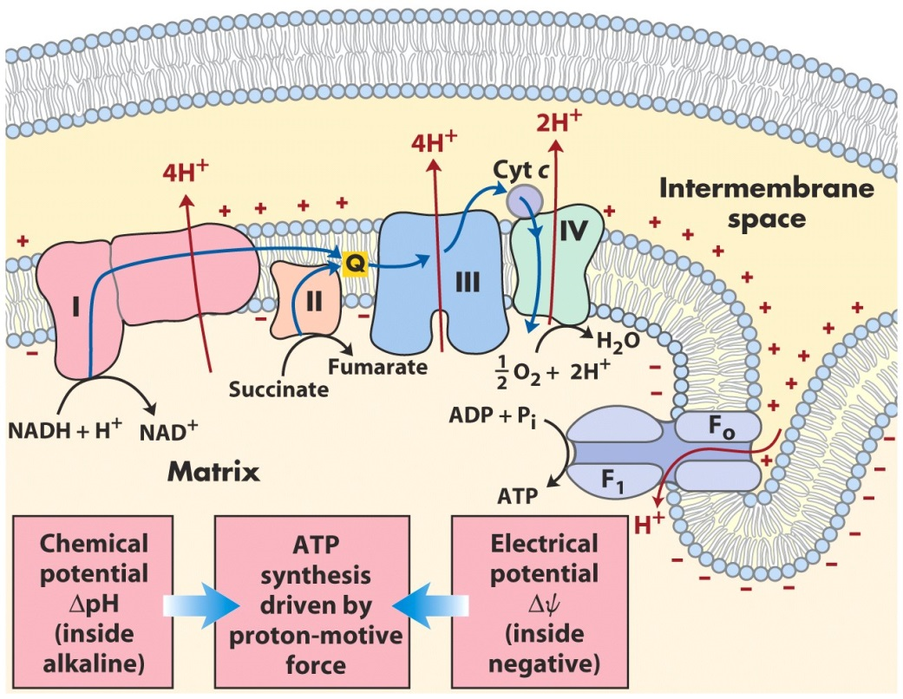
The respiratory control
Under most physiological conditions, electron transport is tightly coupled to phosphorylation.
Electrons do not usually flow through the electron-transport chain to O₂ unless ADP is simultaneously phosphorylated to ATP.
Oxidative phosphorylation requires a supply of NADH (or other source of electrons at high potential), O₂, ADP, and P_{i}.
The most important factor (rate limiting) in determining the rate of oxidative phosphorylation is the level of ADP.
The rate of oxygen consumption by the mitochondria increases markedly when ADP is added and then returns to its initial value when the added ADP has been converted into ATP.
Notes:
We use o2 to generate energy!

Slide 38

The Respiratory Control
The rate of oxidative phosphorylation is determined by the need for ATP: the ADP level increases when ATP is consumed, and so oxidative phosphorylation is coupled to the utilization of ATP. Electrons do not flow from fuel molecules to O₂ unless ATP needs to be synthesized.
The level of ADP also affects the rate of the citric acid cycle because of its need for NAD⁺ and FAD.
If ATP is high (e.g. when we do not excise to convert ATP into ADP), NADH will be high, citric acid cycle slows down. What happens to acetyl-CoA? Converted to fat!!!
Notes:
Why we get fat if we do not exercise to burn off ATP

Slide 39
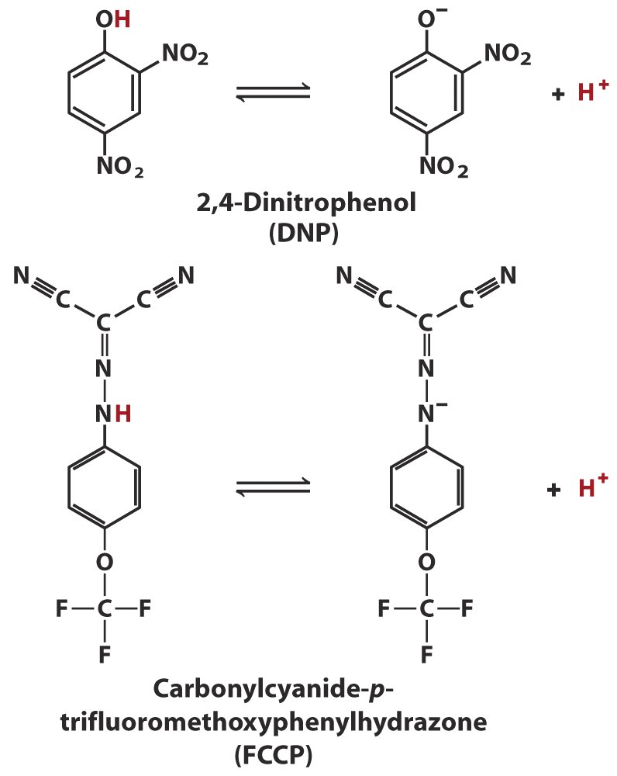
Uncouplers dissipate the proton gradient
DNP and FCCP are weak acids with hydrophobic property that permits them to diffuse across the mitochondrial membrane.
Outside and in the intermembrane space, they are in the acid (protonated) form, and diffuse into the matrix. They release a proton in the matrix, thus dissipating the proton gradient.
Without the proton gradient, can we make ATP? What happens to the ADP level? What happens to electron transfer and NADH? What happens to glycolysis and citric acid cycle?
Can we lose weight then?
Notes:
Making holes on the membrane, lose H+ gradient. The

Slide 40
Uncouplers dissipate the proton gradient
DNP and FCCP are weak acids with hydrophobic property that permits them to diffuse across the mitochondrial membrane.
Outside and in the intermembrane space, they are in the acid (protonated) form, and diffuse into the matrix. They release a proton in the matrix, thus dissipating the proton gradient.
Without the proton gradient, can we make ATP? What happens to the ADP level? What happens to electron transfer and NADH? What happens to glycolysis and citric acid cycle?
Can we lose weight then?
FDA banned this in 1938!!!
Notes:
Making holes on the membrane, lose H+ gradient. The

Slide 41
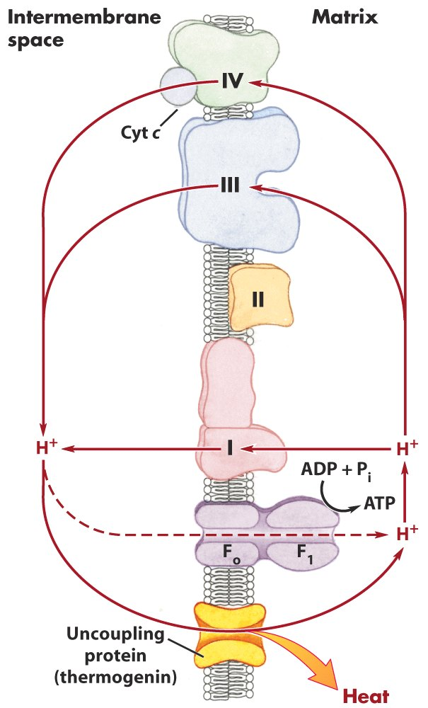
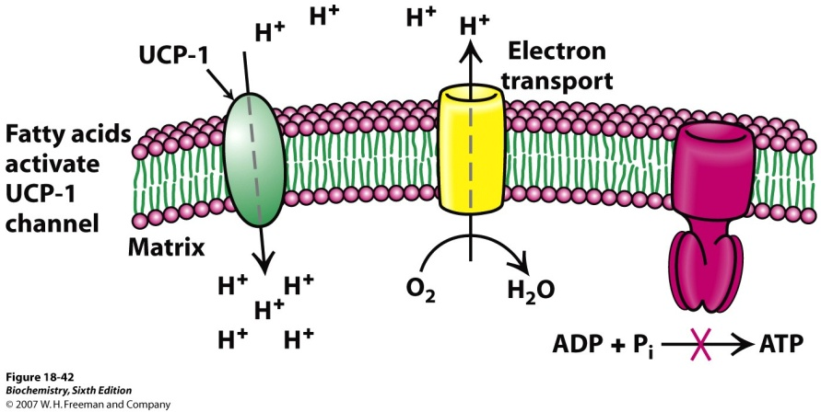
Mitochondria produces heat
Uncoupling protein (UCP) short-circuits the proton gradient to return to the matrix, with the energy dissipated as heat.
Hibernating animals also depend on the activity of uncoupling protein in mitochondria to generate heat during dormancy.

Slide 42
Important points
Location of oxidative phosphorylation.
Brief description of oxidative phosphorylation.
ATP formation is coupled to electron transfer.
The activity of complexes in electron transfer and proton pumping.

